Slide 1
CSS and HostGator
CIS2336

Slide 2
Outline
Reminder – Homework Due February 6 midnight
HostGator Account Set Up
CSS – Make it look pretty!
Rulesets
Selectors
Identifying Problems
Final Project Rubric will be discussed next class. It on Blackboard

Slide 3

HostGator Account
Username
Cougarnet username + f18
lstewardf18
Password
I(#1DboTKbw=
http://heyuhnem.com/cpanel
Any problem with setting up? Use today
Time.

Slide 4
Style your index.html
<!doctype html>
<html>
<head>
<title>My First Web App</title>
<link href='style.css' rel='stylesheet' type='text/css'>
</head>
<body>
<h1>Hello, World!</h1>
<p>This is a paragraph.</p>
</body>
</html>
body {
background: lightcyan;
width: 800px;
margin: auto;
}
h1 {
color: maroon;
text-align: center;
}
p {
color: gray;
border: 1px solid gray;
padding: 10px;
}
Styled_File

Slide 5
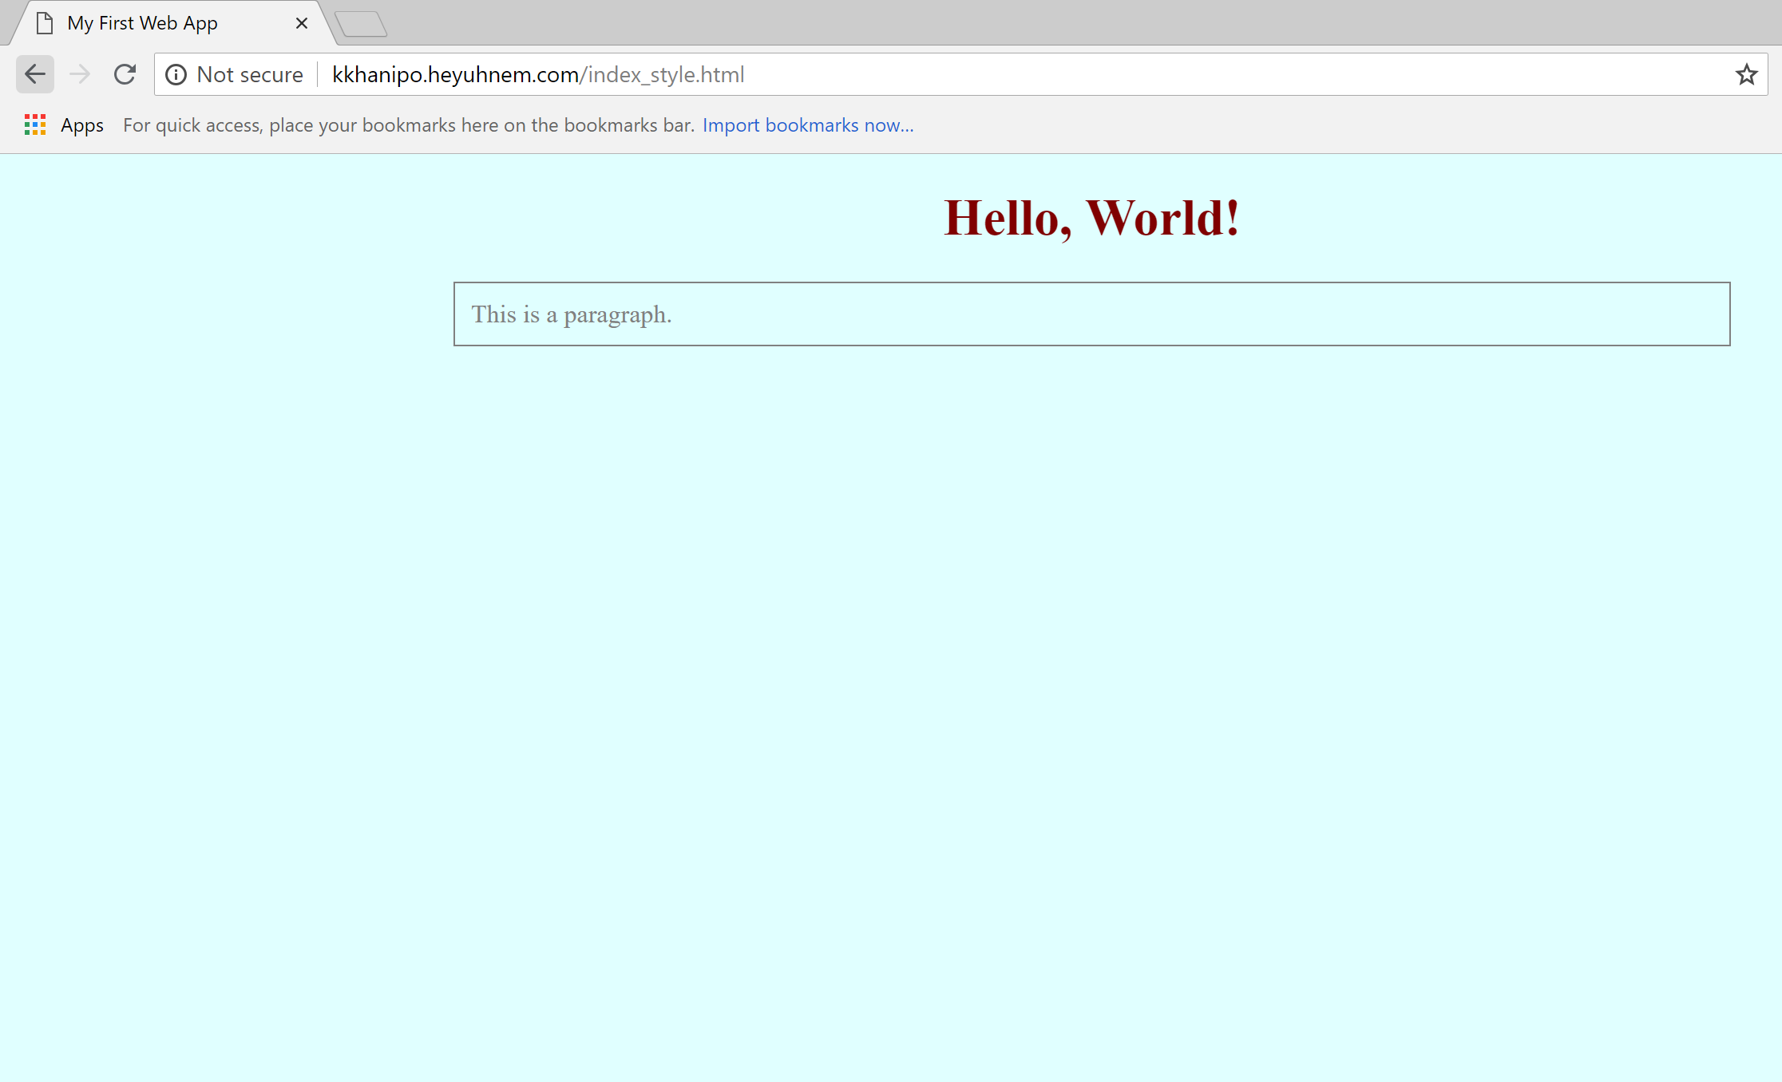

Slide 6
CSS – Rulesets
CSS represents a set of style rules that apply
Selector
Opening Curly Bracket
Property, followed by colon
Value, followed by semicolon
Closing Curly Bracket
body {
background: lightcyan;
width: 800px;
margin: auto;
}

Slide 7
Responsive Web Design
Used in Final project

Slide 8
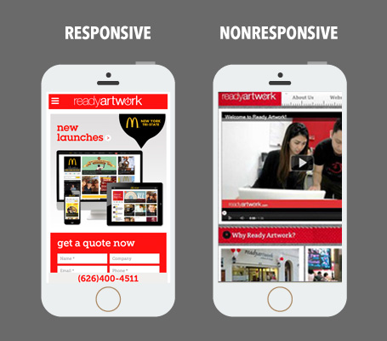
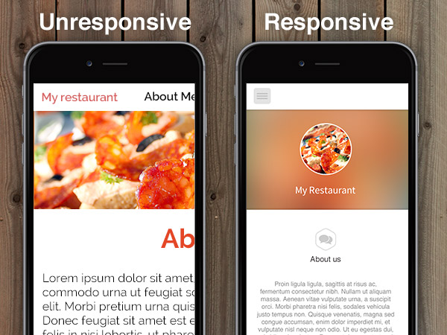
Responsive Design
Automatically adjusts layout based on the height and width of the browser
Notes:
https://www.readyartwork.com/wp-content/uploads/2014/10/responsive_website.jpg
http://3vbiz.com/wp-content/uploads/2015/10/responsive-vs-unresponsive-website.jpg

Slide 9
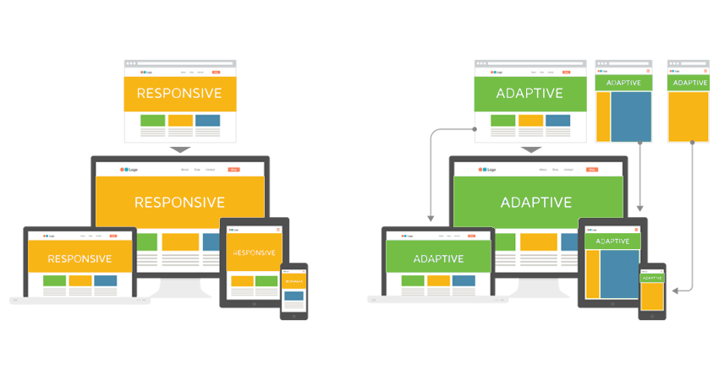
Web Design Strategy
Adaptive
Responsive
Provides optimal viewing experience for a set of screen sizes
Generally doesn’t respond once loaded
Provides optimal viewing experience of a website, no matter what type of device the user is seeing it on
Changes according to screen size “at runtime”
Notes:
https://www.amarinfotech.com/responsive-vs-adaptive-web-design.html

Slide 10
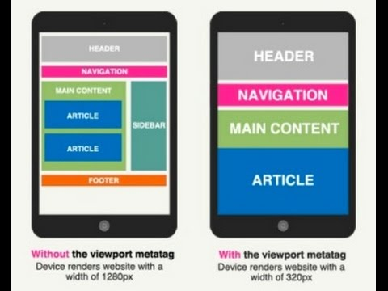
Viewports
Viewport is the user's visible area of a web page
When too big, page gets scaled down to fit
HTML5 introduced ability to manipulate viewports
<meta name="viewport" content="width=device-width, initial-scale=1.0">

Slide 11
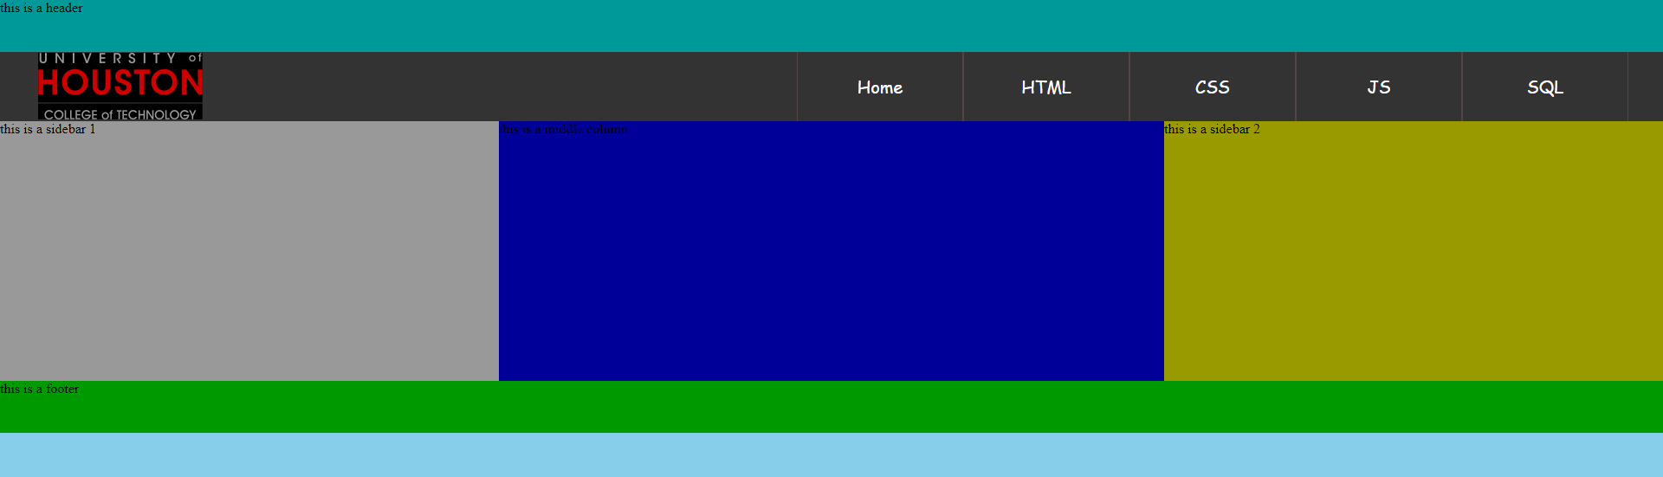
Practical Implementation: Navigation Bar

Slide 12
Creating Home page with liquid design Check on http://www.responsinator.com/
DIY

Slide 13
Code
Create basic webpage index.html and style.css and transfer to HG
Add title: UH, CIS, College of technology, Fofanova
Add comments: Class, semester, year, name
Create Header with ID as DIV (logical division)
https://www.youtube.com/watch?v=WOQJIVcxeQY
https://www.youtube.com/watch?v=Q7eoOSZ7JdY&list=PL081AC329706B2953&index=9
https://www.youtube.com/watch?v=P71U-doyzNg&index=10&list=PL081AC329706B2953
https://www.youtube.com/watch?v=8uTNq7fs5-s&index=11&list=PL081AC329706B2953

